Slide 1
과제 발표
20200907 김지혜

Slide 2
1. 모델 1(기본)
import keras from keras import models, layers from tensorflow.python.keras.utils import np_utils # to_categorical from tensorflow import keras import matplotlib.pyplot as plt
(x_train, y_train), (x_test, y_test) = keras.datasets.mnist.load_data()
num_classes = 10 input_shape = (28, 28, 1) x_train = x_train.astype('float32') / 255.0 x_test = x_test.astype('float32') / 255.0 y_train = np_utils.to_categorical(y_train) y_test = np_utils.to_categorical(y_test) # print('y_train :', np.shape(y_train)) # (60000, 10) model = keras.Sequential( [ keras.Input(shape=input_shape), layers.Conv2D(32, kernel_size=(3, 3), activation="relu"), layers.MaxPooling2D(pool_size=(2, 2)), layers.Conv2D(64, kernel_size=(3, 3), activation="relu"), layers.MaxPooling2D(pool_size=(2, 2)), layers.Flatten(), layers.Dropout(0.5), layers.Dense(num_classes, activation="softmax"), ] ) model.summary()
keras로부터 mnist dataset load
클래스 10개, 이미지 크기 28x28, 채널 1개
0~1 정규화, 원-핫 인코딩
순차적 Sequential 모델
2개의 Convolution layer
2개의 MaxPooling layer
Flatten layer
Dropout layer(0.5%)
Dense layer(softmax)

Slide 3
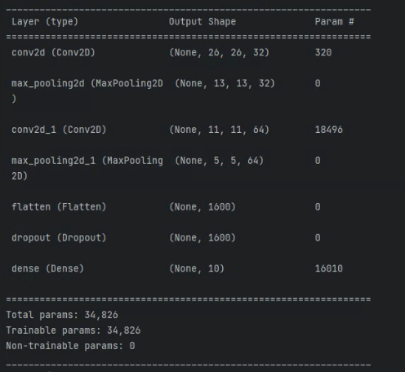
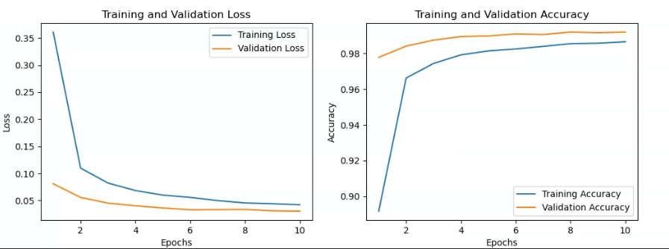
2. 모델 1(기본)
batch_size = 128 epochs = 10 model.compile(loss="categorical_crossentropy", optimizer="adam", metrics=["accuracy"]) history = model.fit(x_train, y_train, batch_size=batch_size, epochs=epochs, validation_split=0.1) score = model.evaluate(x_test, y_test, verbose=0) print("Test loss:", score[0]) print("Test accuracy:", score[1])
Test loss: 0.026004018262028694
Test accuracy: 0.9907000064849854
(3*3*1 +1)*32=320
(3*3*32 +1)*64=18496
5*5*64=1600
(1600 +1)*10=16010

Slide 4
3. 모델2(Grid Search)
from sklearn.model_selection import GridSearchCV
grid_search(): 최적의 하이퍼파라미터 탐색
create_model(): grid_result에 저장된 최적 모델 생성
conv_layers, dense_layers, dropout, learning_rate
훈련 후 trained_model로 저장
num_classes = 10 input_shape = (28, 28, 1) (x_train, y_train), (x_test, y_test) = mnist.load_data() x_train = x_train.astype('float32') / 255.0 x_test = x_test.astype('float32') / 255.0 y_train = keras.utils.to_categorical(y_train, num_classes) y_test = keras.utils.to_categorical(y_test, num_classes) grid_result = grid_search(x_train, y_train) model = create_model(conv_layers=grid_result.best_params_['conv_layers'], dense_layers=grid_result.best_params_['dense_layers'], dropout=grid_result.best_params_['dropout'], learning_rate=grid_result.best_params_['learning_rate'] ) model.save("trained_model.h5") history = model.fit(x_train, y_train, epochs=grid_result.best_params_['epochs'], batch_size=grid_result.best_params_['batch_size'], verbose=1, validation_split=0.1) scores = model.evaluate(x_test, y_test) print('Best accuracy: {0:.4f}, Best Params: {1}'.format(grid_result.best_score_, grid_result.best_params_)) print("Accuracy: {0} Error: {1:.4f}".format(scores[1], (1 - scores[1]) * 100))

Slide 5
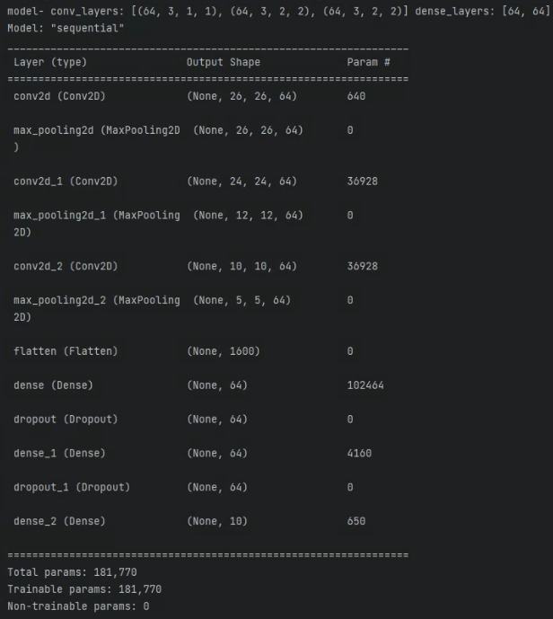
4. 모델 2(Grid Search)
def grid_search(train_images, train_labels): mnist_cnn_model = KerasClassifier(build_fn=create_model, verbose=1) param_grid = { 'conv_layers': [ [(32, 5, 2, 2), (64, 3, 2, 2)], [(64, 3, 1, 1), (64, 3, 2, 2), (64, 3, 2, 2)], [(64, 3, 2, 2), (64, 3, 2, 2), (64, 3, 2, 2)], [(64, 3, 1, 1), (128, 3, 1, 1)], ], 'dense_layers': [ [64], [128], [64, 64], ], 'dropout': [0.3, 0.5], 'epochs': [10], 'batch_size': [32, 64], 'learning_rate': [0.001, 0.003] } grid = GridSearchCV(estimator=mnist_cnn_model, param_grid=param_grid, cv=2, n_jobs=None, verbose=1) try: grid_result = grid.fit(train_images, train_labels) print('Best accuracy: {0:.4f}, Best Params: {1}'.format(grid_result.best_score_, grid_result.best_params_)) except Exception as e: print(f"An error occurred during grid search: {str(e)}") return grid_result

Slide 6
5. 모델 2(Grid Search)
param_grid = {
'conv_layers': [
[(64, 3, 1, 1), (64, 3, 2, 2), (64, 3, 2, 2)],
],
'dense_layers': [
[64, 64],
],
'dropout': [0.3],
'epochs': [10],
'batch_size': [32],
'learning_rate': [0.001]
}
1. 3개의 convolution layer
2. flatten()
3. 2개의 dense layer
4. dense layer(softmax)
def create_model(conv_layers, dense_layers, dropout, learning_rate): print('model- conv_layers:', conv_layers, 'dense_layers:', dense_layers, 'dropout:', dropout, 'learning_rate:', learning_rate) model = Sequential() conv_layers_count = 0 optimizer = Adam(learning_rate=learning_rate) # Pass learning_rate to the optimizer for (filters, kernel_size, pooling_size, pool_stride) in conv_layers: conv_layers_count += 1 if conv_layers_count == 1: model.add( Conv2D(filters, (kernel_size, kernel_size), strides=(1, 1), activation='relu', input_shape=(28, 28, 1))) model.add(MaxPooling2D(pool_size=(pooling_size, pooling_size), strides=(pool_stride, pool_stride))) else: model.add(Conv2D(filters, (kernel_size, kernel_size), strides=(1, 1), activation='relu')) model.add(MaxPooling2D(pool_size=(pooling_size, pooling_size), strides=(pool_stride, pool_stride))) model.add(Flatten()) for nodes in dense_layers: model.add(Dense(nodes, activation='relu')) model.add(Dropout(dropout)) model.add(Dense(10, activation='softmax')) model.compile(optimizer=optimizer, loss='categorical_crossentropy', metrics=['accuracy']) model.summary() return model

Slide 7
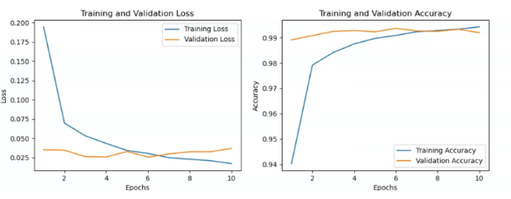
6. 모델 2(Grid Search)
param_grid = { 'conv_layers': [ [(32, 5, 2, 2), (64, 3, 2, 2)], [(32, 5, 2, 2), (64, 3, 2, 2), (128, 3, 2, 2)], [(64, 3, 1, 1), (64, 3, 2, 2), (64, 3, 2, 2)] ], 'dense_layers': [ [64], [128], [64, 64] ], 'dropout': [0.3, 0.5], 'epochs': [10], 'batch_size': [32], 'learning_rate': [0.001] }
Best accuracy: 0.9901
Best Params: {'batch_size': 32, 'conv_layers': [(64, 3, 1, 1), (64, 3, 2, 2), (64, 3, 2, 2)], 'dense_layers': [128], 'dropout': 0.5, 'epochs': 10, 'learning_rate': 0.001}
Accuracy: 0.9929999709129333 Error: 0.7000

Slide 8
7. 모델 2(Grid Search)
param_grid = { 'conv_layers': [ [(32, 5, 2, 2), (64, 3, 2, 2)], [(64, 3, 1, 1), (64, 3, 2, 2), (64, 3, 2, 2)], [(64, 3, 2, 2), (64, 3, 2, 2), (64, 3, 2, 2)], [(64, 3, 1, 1), (128, 3, 1, 1)], ], 'dense_layers': [ [64], [128], [64, 64], ], 'dropout': [0.3, 0.5], 'epochs': [10], 'batch_size': [32, 64], 'learning_rate': [0.001, 0.003] }
model- conv_layers: [(64, 3, 1, 1), (128, 3, 1, 1)] dense_layers: [64, 64] dropout: 0.3 learning_rate: 0.001
Total params: 4,797,962
model- conv_layers: [(64, 3, 1, 1), (128, 3, 1, 1)] dense_layers: [128] dropout: 0.3 learning_rate: 0.001
Total params: 9,513,098
model- conv_layers: [(64, 3, 1, 1), (128, 3, 1, 1)] dense_layers: [64] dropout: 0.3 learning_rate: 0.001
Total params: 4,793,802
dense layer의 파라미터 수가 대부분
->레이어나 파라미터를 늘려도 성능이 유의미하게 향상되지 않음

Slide 9
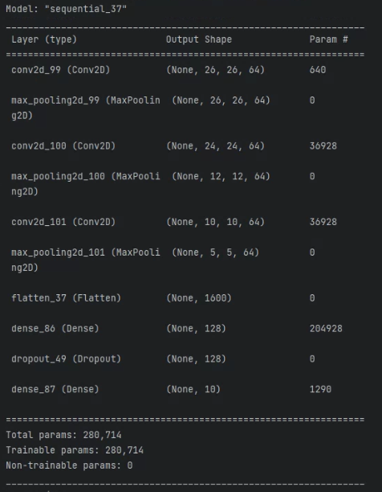
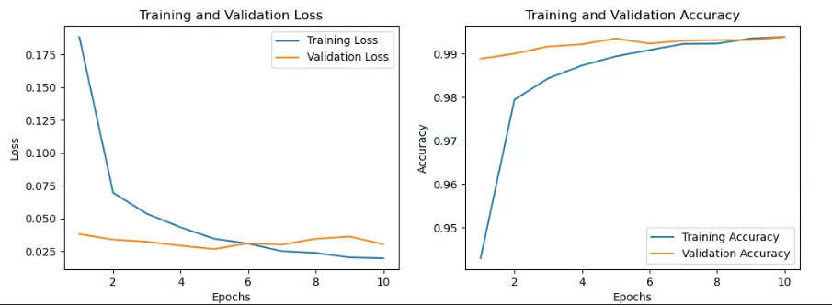

8. 모델 평가
loaded_model = keras.models.load_model("trained_model_3.h5") loaded_model.summary() batch_size = 32 epochs = 10 loaded_model.compile(loss="categorical_crossentropy", optimizer="adam", metrics=["accuracy"]) history = loaded_model.fit(x_train, y_train, batch_size=batch_size, epochs=epochs, validation_split=0.1) score = loaded_model.evaluate(x_test, y_test, verbose=0) print("Test loss:", score[0]) print("Test accuracy:", score[1])

Slide 10
감사합니다.

